Slide 1
Mastering System Design
Section 5: Web Concepts in System Design
System Design Fundamentals

Slide 2
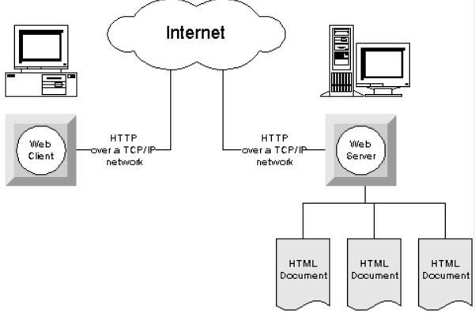
Why Learn Web Concepts?
Importance of web principles in modern system design
Impact on scalability, security, and performance
How understanding these concepts helps in system design interviews

Slide 3
Section Agenda
Web Sessions: Managing State in Web Applications
Serialization: Data Exchange & Storage Formats
CORS: Cross-Origin Resource Sharing & Web Security
Summary & Practical Applications

